Slide 1
UNECE Brochure for Walnuts
Photos
7 April 2014

Slide 2
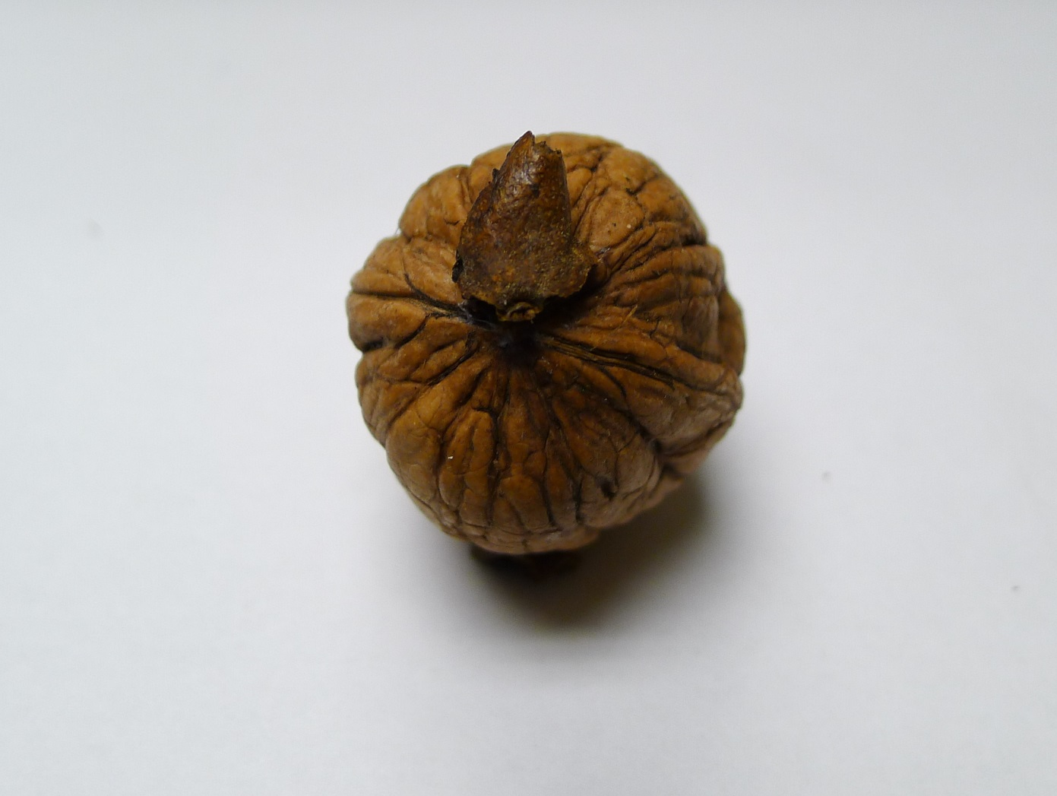
Adhering Husk/Hull < 10% (allowed). Photo 1

Slide 3
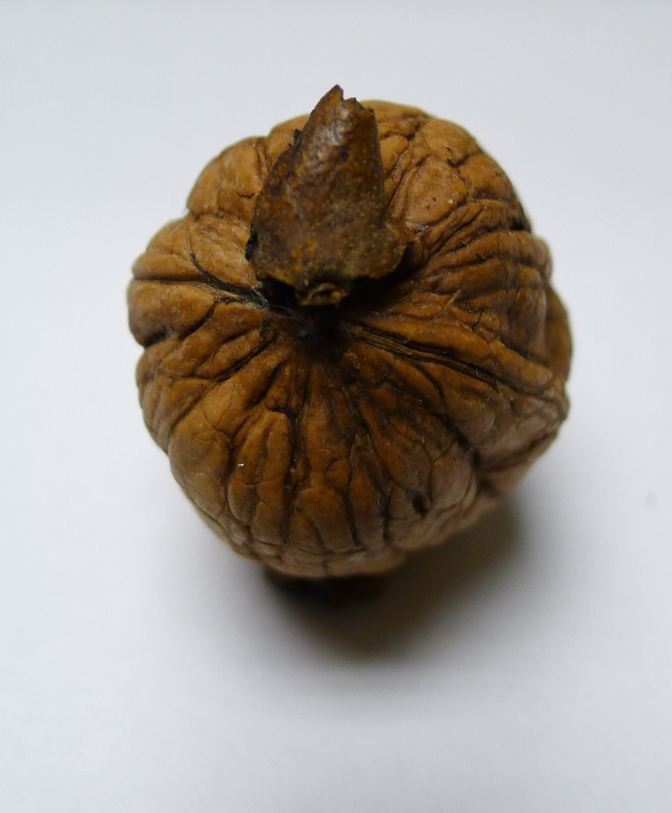
Adhering Husk/Hull < 10% (allowed). Photo 2

Slide 4
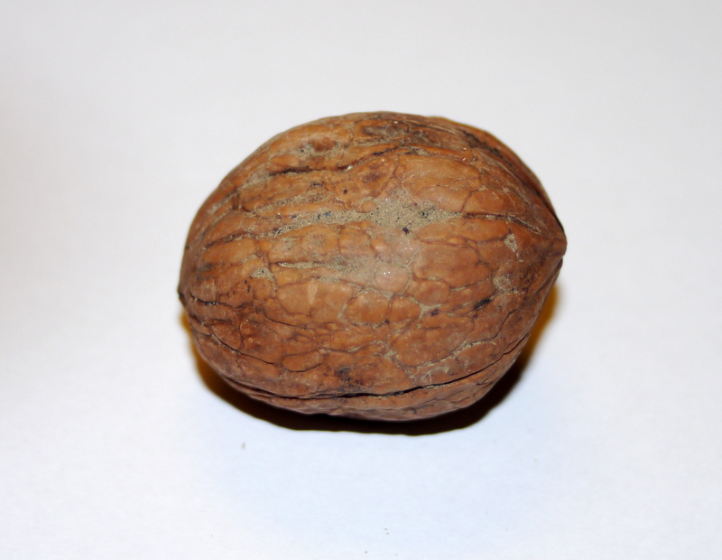
Dirt < 10% (Allowed): Photo 1

Slide 5
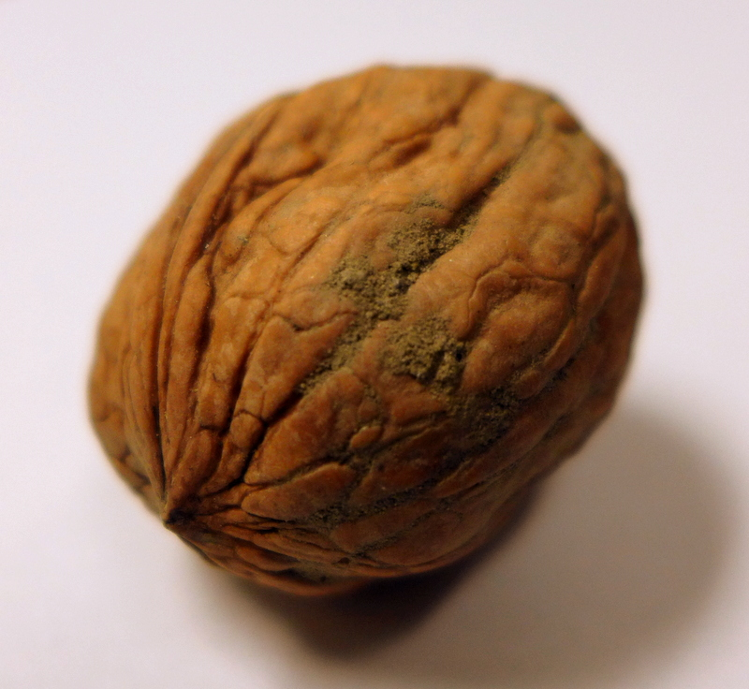
Dirt < 10% (Allowed): Photo 2

Slide 6
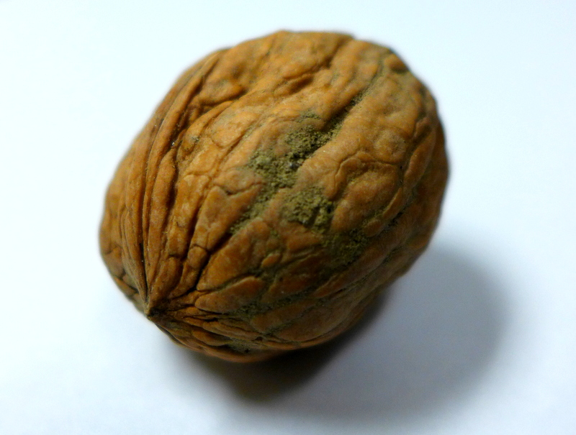
Dirt < 10% (Allowed): Photo 3

Slide 7
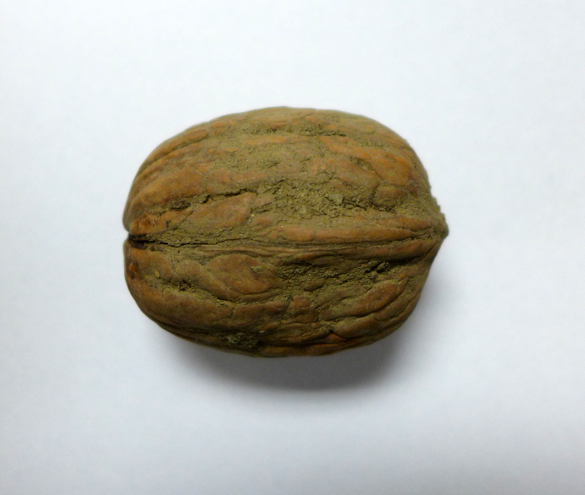
Dirt > 10% (Not Allowed): Photo 1

Slide 8
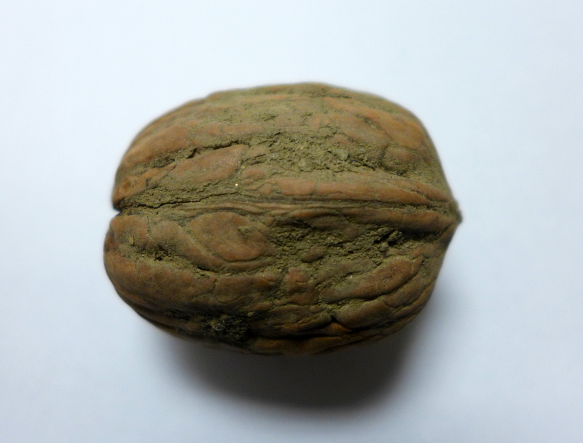
Dirt > 10% (Not Allowed): Photo 2

Slide 9
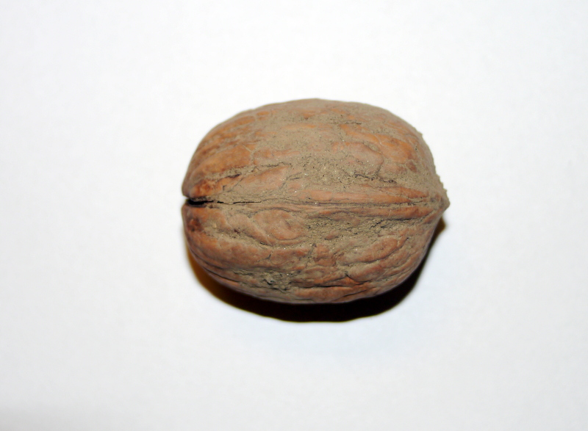
Dirt > 10% (Not allowed): Photo 3

Slide 10
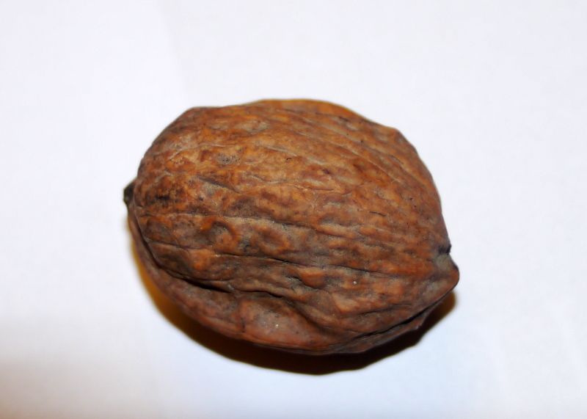
Misshapen (Allowed): Photo 1

Slide 11
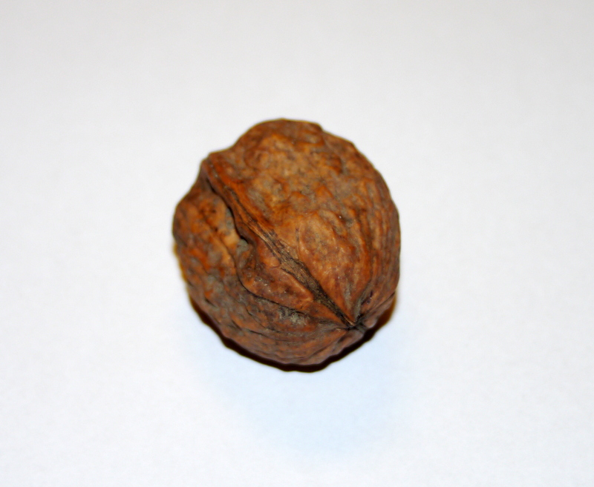
Misshapen (Allowed): Photo 2

Slide 12
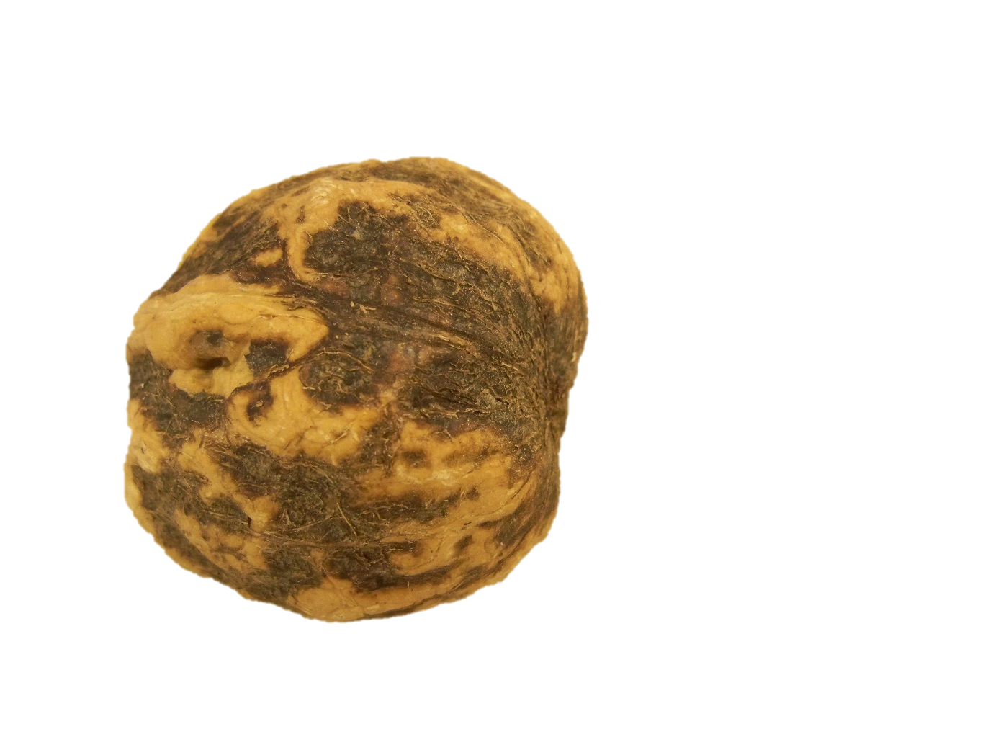
Spread Stain: Not Allowed

Slide 13
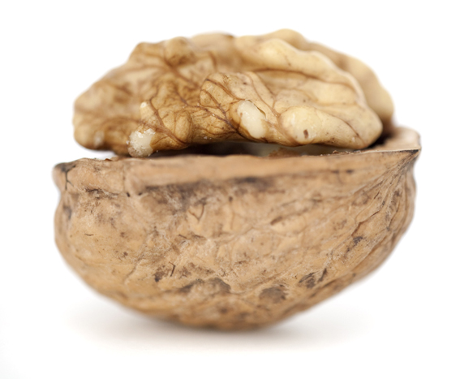
Well Formed Kernels: Photo 1

Slide 14
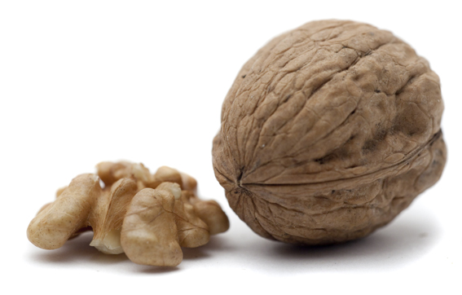
Well Formed Kernels: Photo 2

Slide 15
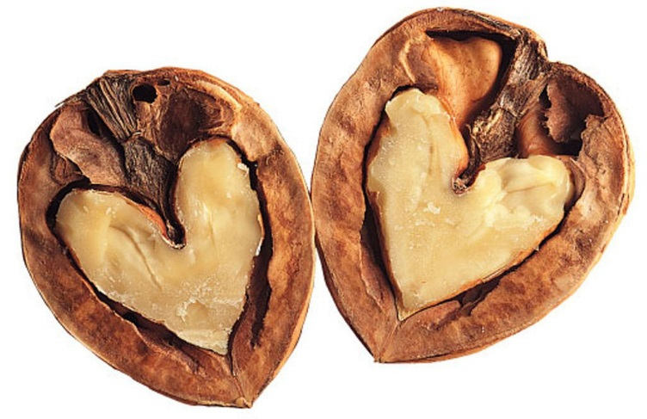
Well Formed Kernels: Photo 3

Slide 16
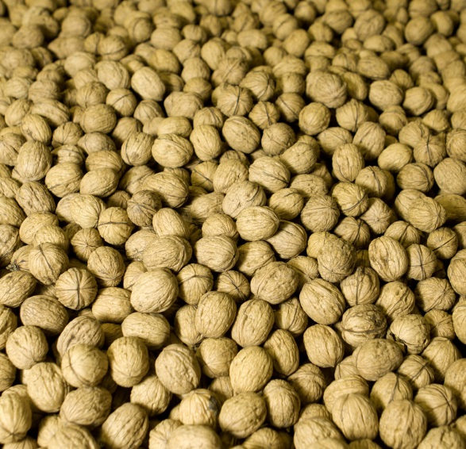
Unbleached Walnuts

Slide 17
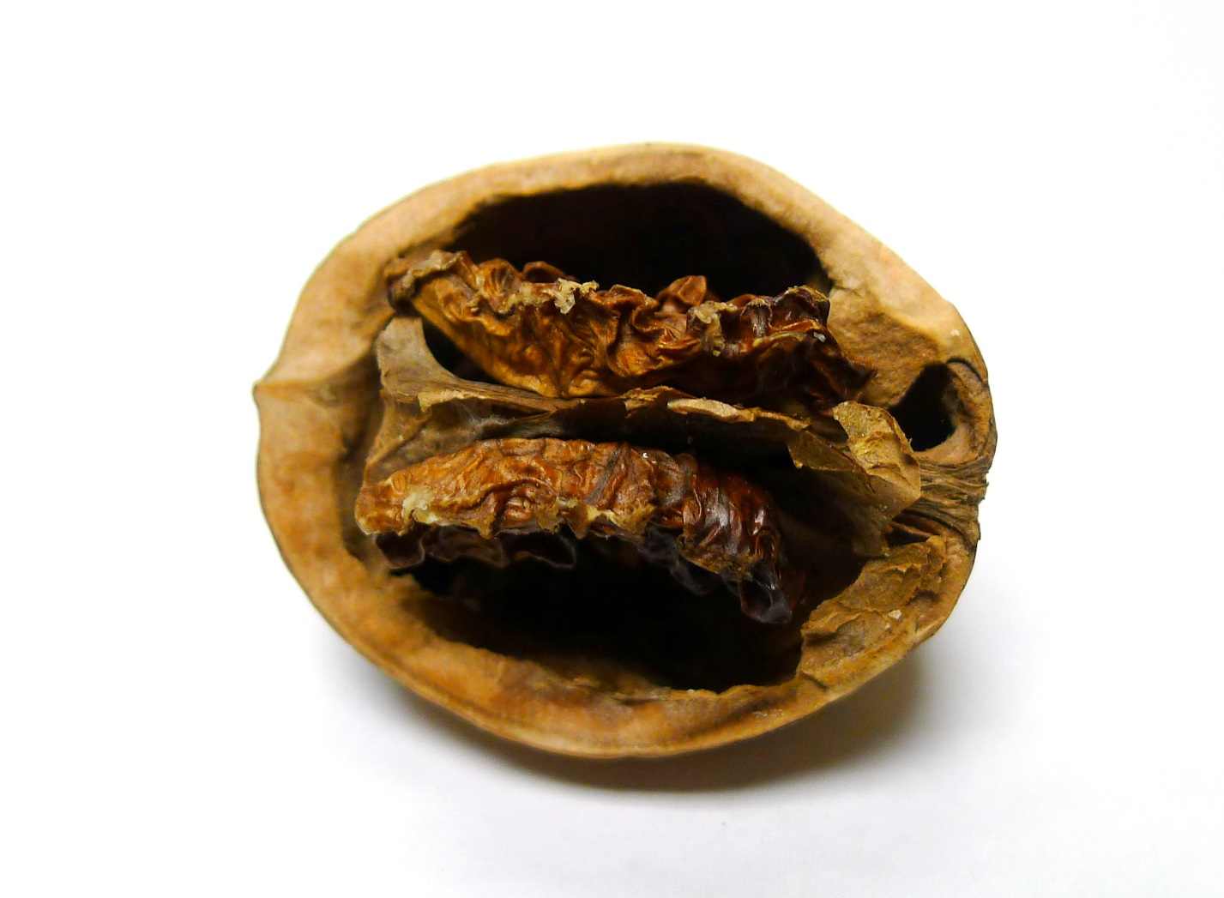
Shriveled Nuts (Not Allowed): Photo 1

Slide 18
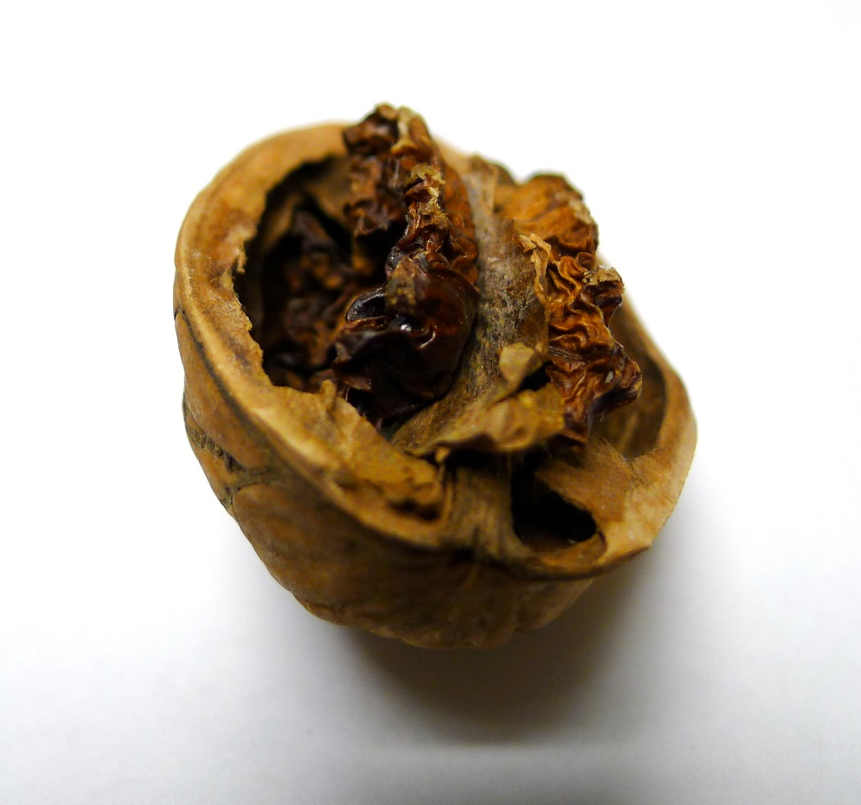
Shriveled Nuts (Not Allowed): Photo 2

Slide 19
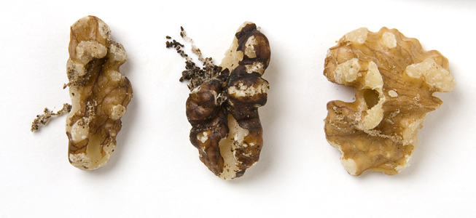
Insect Damage

Slide 20
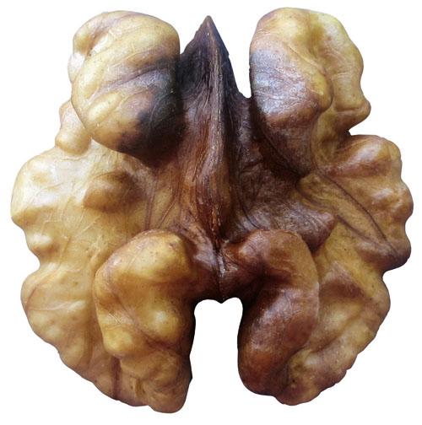
Stained/Discolored Kernel

Slide 21
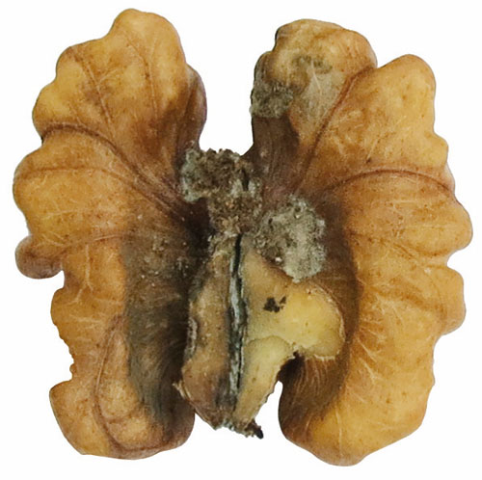
Mold on Kernels (Not Allowed): Photo 1

Slide 22
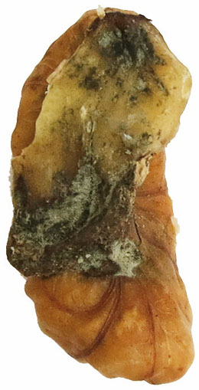
Mold on Kernels (Not Allowed): Photo 2

Slide 23
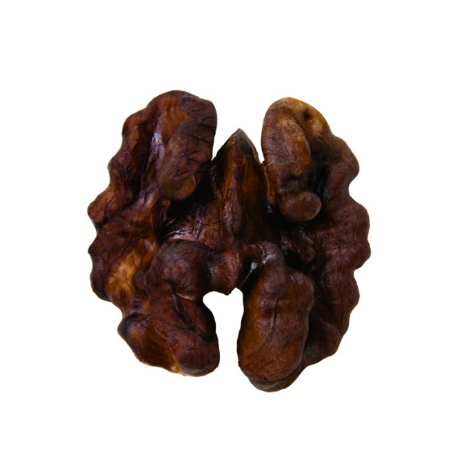
Sunburnt Kernels

Slide 24
Retail Pack

Slide 25
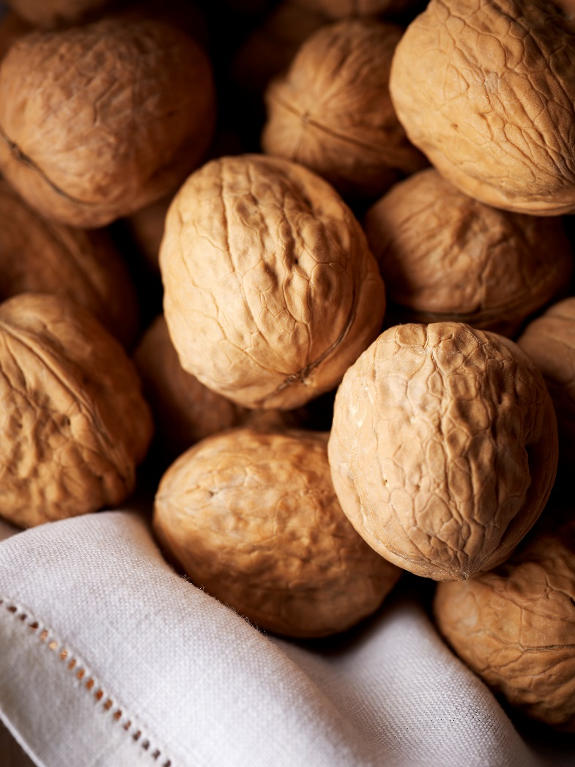
Beauty Shots: Photo 1

Slide 26
Beauty Shots: Photo 2

